Slide 1


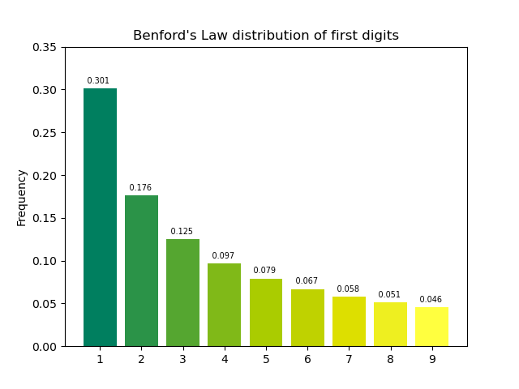
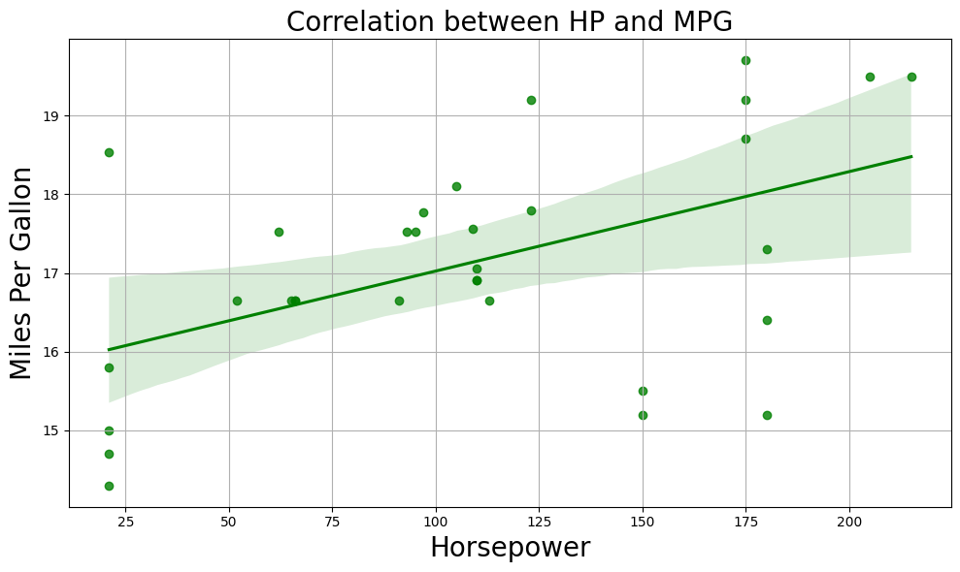

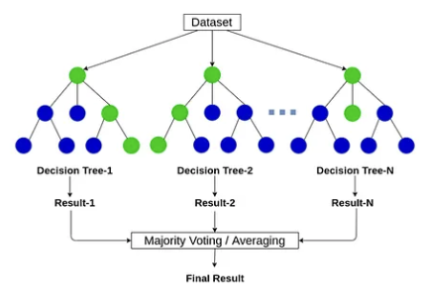
Detection of Correlation Reversal Manipulation
via Benford’s Law and Random Forest
Benford’s Law
(Statistical Analysis)
Positive
Correlation
From a given data:
r = 0.5, p = 3.5e-03
“The more horsepower we have,
the more miles per gallon we get.”
Random Forest
(Machine Learning)
Q: Is this true?
Poj Netsiri 2025

Slide 2
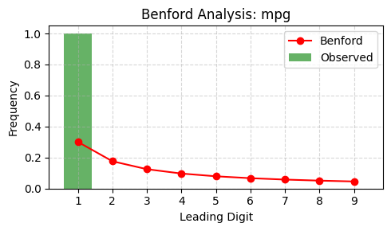
Using Benford’s Law to Detect Manipulation
Chi-square = 74.3017, p-value = 0.0000000000006
Criteria: Chi-square > 30.58 and p < 0.0001
Classified as manipulated (anomaly and extreme)

Slide 3
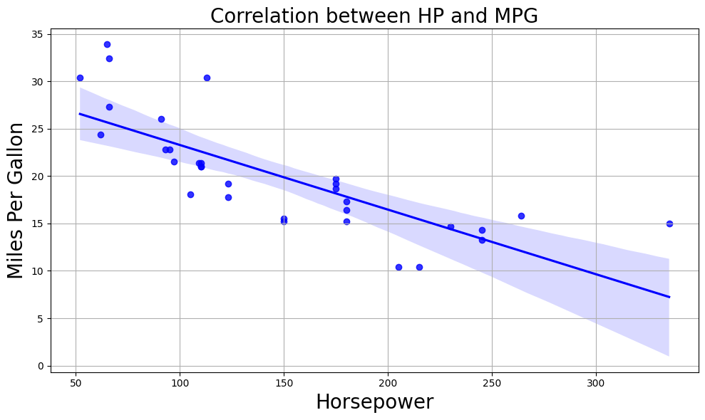
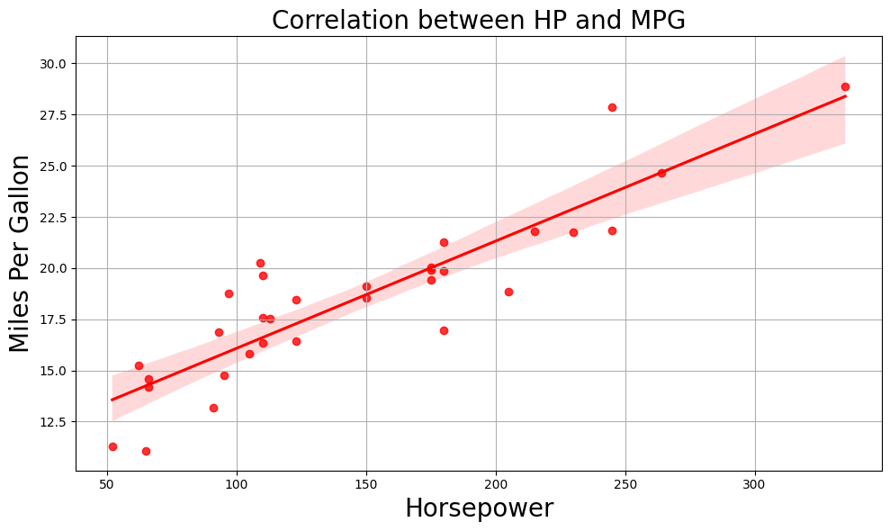
Using Random Forest to Detect Manipulation
Original Data (Label=0)
Supervised Training
RF Model
Manipulated Data (Label=1)
New Manipulated Data
Classifier
RF Model
Classified as manipulated

Slide 4
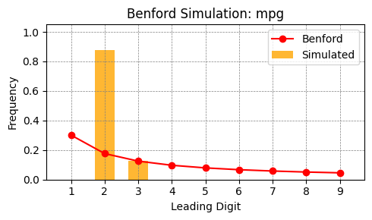
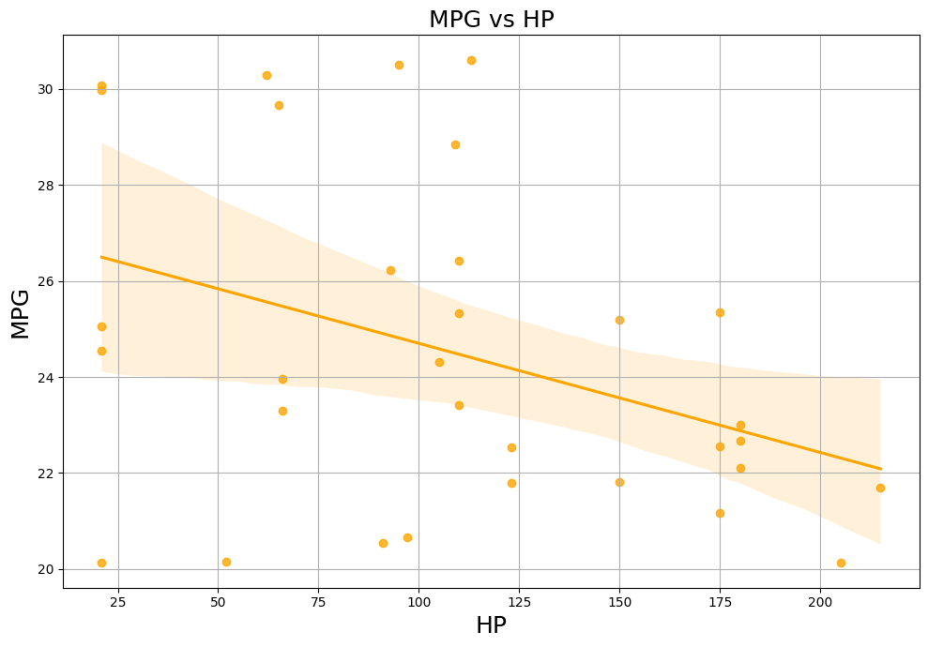
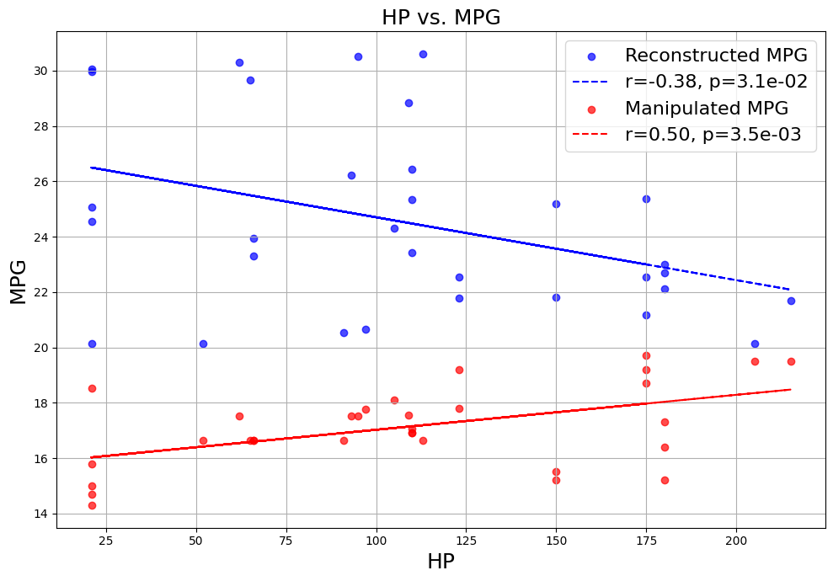
Using Benford’s Law to Detect Correlation Reversal
Stochastic Simulation
Reconstructed Data
Negative
Correlation

Slide 5
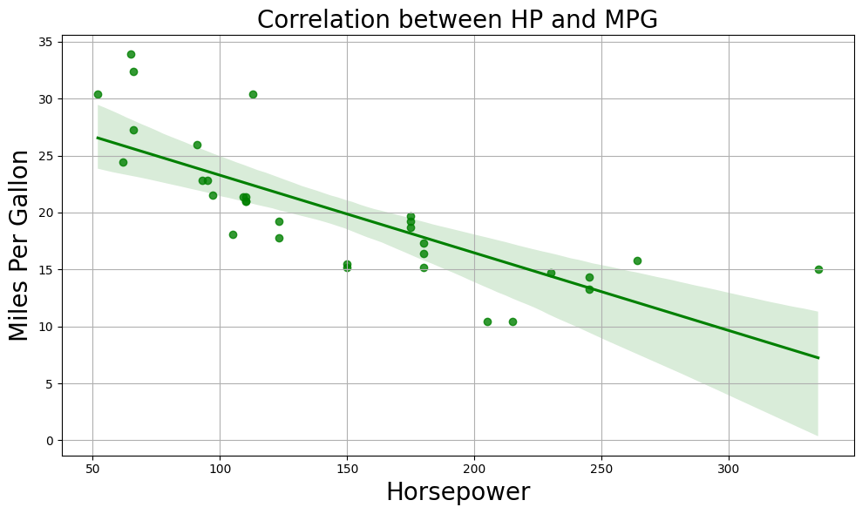
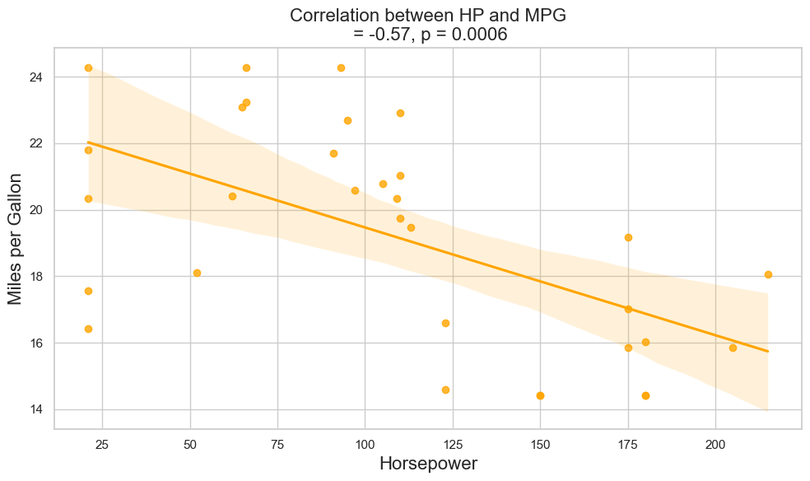
Using Random Forest to Detect Correlation Reversal
Original Data
Training
RF Model
Manipulated Data
Reconstructed Data
Regression
Negative
Correlation
RF Model

Slide 6
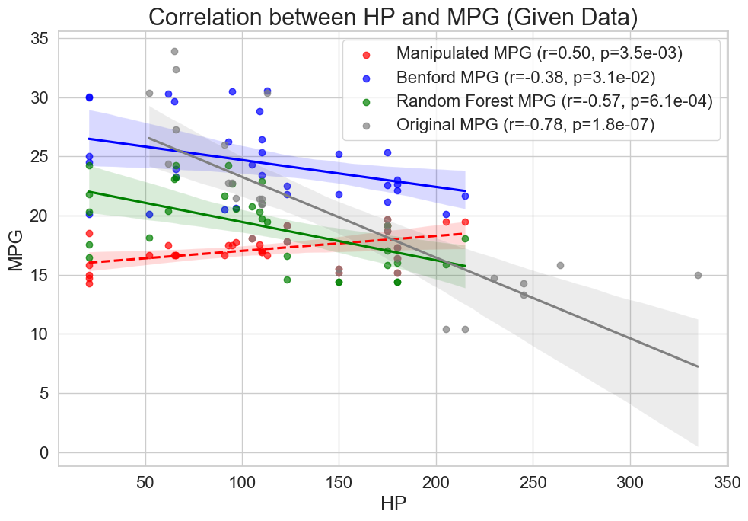
“The more horsepower we have,
the fewer miles per gallon we get.”

Slide 7
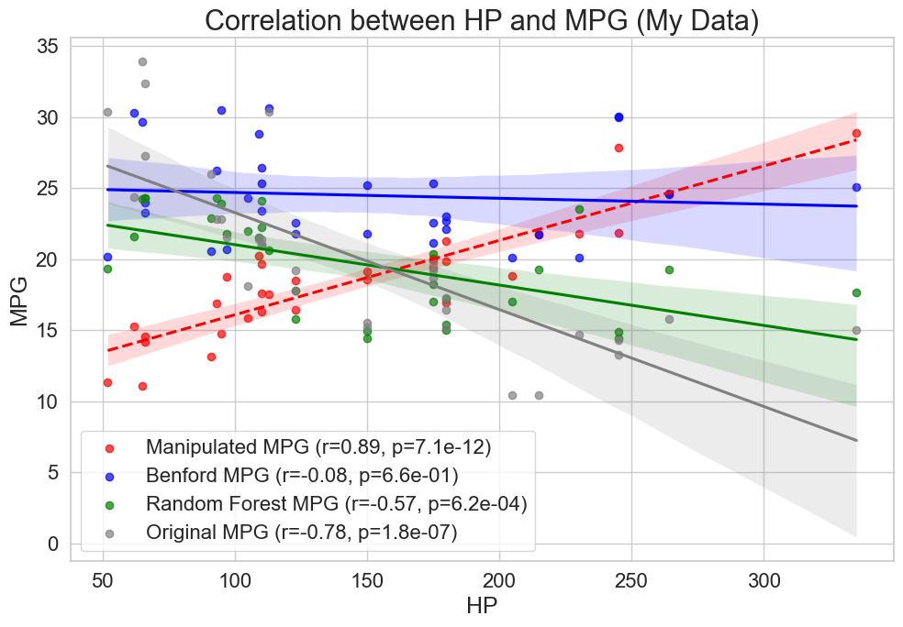
“The more horsepower we have,
the fewer miles per gallon we get.”

Slide 8
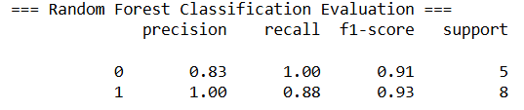
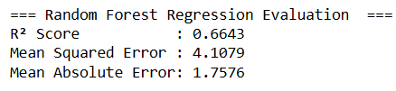
Evaluation of Random Forest Classifier and Regressor

Slide 9
Conclusion
1. Benford’s law can detect data manipulation and correlation reversal.
2. Random Forest Algorithm can also detect data manipulation
and correlation reversal.
3. Random Forest could approximate original data better
than Benford’s law (84% vs. 45%).
4. The original data was manipulated to show positive correlation
between HP and MPG while still p < 5%.

